Slide 1
React Native Components - Fundamentals
Chapter 15 –
React Native Components - Fundamentals

Slide 2
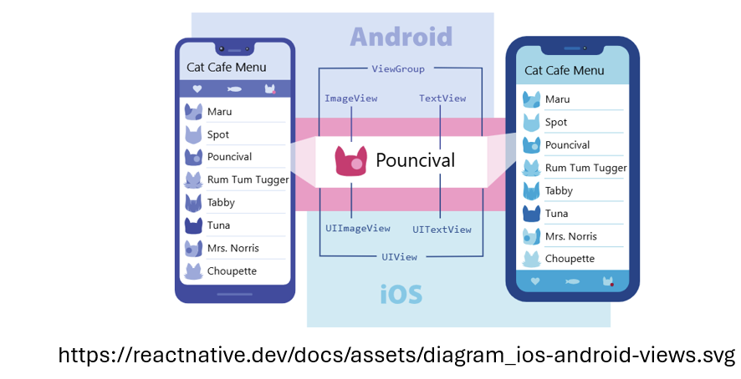
React Native Components - Fundamentals
React Native Components
React Native Components(elements) are the building blocks of a React Native application
They are reusable UI elements that help developers build interfaces for mobile apps using JavaScript/TypeScript and React
Describes how the app looks and behaves using JavaScript/TypeScript + React
Components are reusable and nestable

Slide 3
React Native Components - Fundamentals
Views in Mobile Development
In native Android/iOS, a view = smallest UI unit (text, image, input, etc.)
Views can contain other views which forms a UI hierarchy
In React Native, these views are accessed using JavaScript-based components

Slide 4
React Native Components - Fundamentals
Native Components
Native components are either Android or iOS Platform-backed UI elements created via JavaScript/TypeScript in React Native
They are mapped to Android (Kotlin/Java) and iOS (Swift/Objective-C) views
They give native performance and native look and feel

Slide 5
React Native Components - Fundamentals
Core Components
React Native runs on React, a popular open source library for building user interfaces with JavaScript/TypeScript
Core Components in React Native are the built‑in, cross‑platform UI primitives that map directly to the native widgets on iOS and Android
They serve as the foundation for building your app’s interface using JavaScript or TypeScript
Key characteristics:
Native-backed: Each core component corresponds to a platform view (e.g., <View> → UIView on iOS, ViewGroup on Android)
Reusable & Composable: You can nest them to create complex layouts
Styled with Flexbox: Layout and positioning use the same Flexbox model as on the web

Slide 6
React Native Components - Fundamentals
Core Components
Common Core Components include:
<View>: Container for layout, styling, touch handling
<Text>: Displays styled text and supports nesting
<Image>: Renders images from local assets or remote URIs
<ScrollView>: Scrollable container for content larger than the screen
<TextInput>: Single‑ or multi‑line text entry field
<TouchableOpacity>, <Pressable>: Wrap any component to make it touch‑responsive
These primitives let you build rich, performant mobile UIs that feel truly native on both platforms

Slide 7
React Native Components - Fundamentals
Core Components
In this chapter, we’ll explore few commonly used components:
<View>
<Text>
<Image>

Slide 8
React Native Components - Fundamentals
<View> Element
The View component is the most fundamental building block for creating a UI in React Native
It acts as a container that supports layout using Flexbox, styles, basic touch handling, and accessibility features
The View component directly maps to the native view of the platform, whether it's a UIView on iOS, a <div> on the web, or android.view on Android
View is designed to be nested within other views and can hold any number of child components

Slide 9
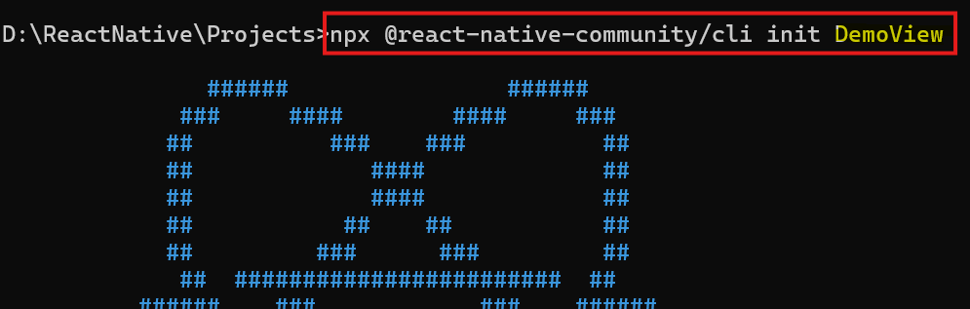
React Native Components - Fundamentals
<View> Element
This example demonstrates how to create a View that contains three colored boxes
Create a new React Native CLI application named ‘DemoView’
npx @react-native-community/cli init DemoView
Open the project in VS Code

Slide 10
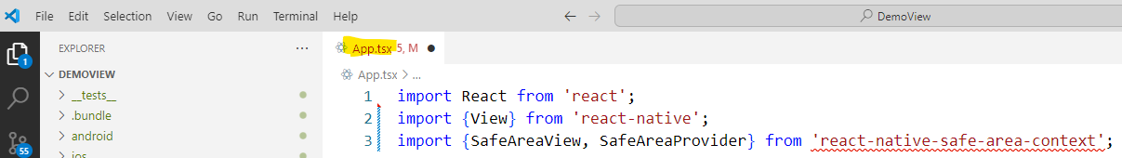
React Native Components - Fundamentals
<View> Element
Replace App.tsx with the below code
Import the required modules:
React: Core library to use React components
View, Text: React Native Core Components
SafeAreaView, SafeAreaProvider: From react-native-safe-area-context, used to prevent content from overlapping with notches, status bars, etc

Slide 11
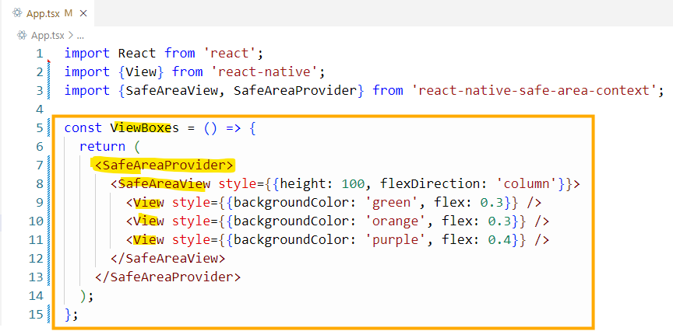
React Native Components - Fundamentals
<View> Element
2. SafeAreaProvider:
Acts as a wrapper to provide safe area metrics to child components
ViewBoxes is a functional component (arrow function) that defines what the component renders
In React Native, a functional component is simply a JavaScript or TypeScript function that returns JSX (or TSX when using TypeScript) – a syntax used to describe the structure of the UI

Slide 12
React Native Components - Fundamentals
<View> Element
3. SafeAreaView:
Ensures that the content inside doesn't overlap with unsafe areas like the notch or status bar
style={{ height: 100, flexDirection: 'row' }} – The ‘style’ property (commonly called ‘props’) sets the height and lays out children horizontally
In this case we are using an inline style with the components which is not the best practice for larger apps
In that case we’ll be using Style Sheets instead of in-line styles
The height is in terms of device independent pixels

Slide 13
React Native Components - Fundamentals
<View> Element
We can also set flex: 1 instead of height so that it takes up the entire available screen height
The child View elements will divide that space proportionally according to their individual flex values (0.3, 0.3, 0.4)
We can also set the color using hex color code
<View style={{backgroundColor: 'green', flex: 0.3}} />
<View style={{backgroundColor: 'orange', flex: 0.3}} />
<View style={{backgroundColor: 'purple', flex: 0.4}} />
<View style={{backgroundColor: '#008000', flex: 0.3}} />

Slide 14
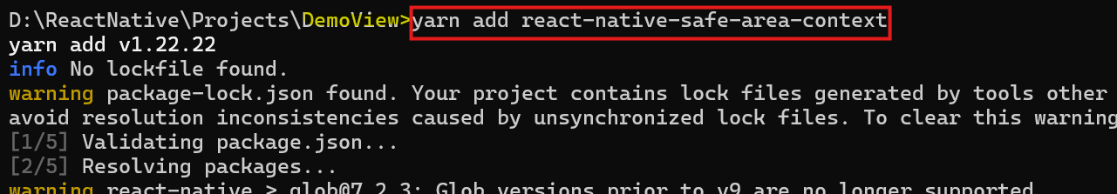
React Native Components - Fundamentals
<View> Element
Install react-native-safe-area-context
react-native-safe-area-context is a library that helps your React Native app respect the safe areas of devices
It is especially important for modern smartphones with notches, rounded corners, and home indicators
Install safe-area-context at the root folder of the project by running the below command
npm install react-native-safe-area-context OR yarn add react-native-safe-area-context

Slide 15
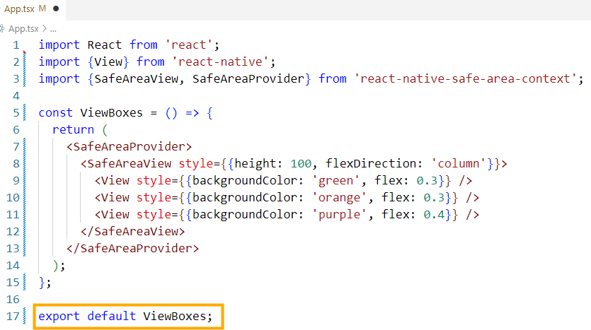
React Native Components - Fundamentals
<View> Element
4. Functional Component Exported:

Slide 16
React Native Components - Fundamentals
<View> Element
export default ViewBoxes;
ViewBoxes is exported as the default functional component
When we say the component is exported, it means that the component is made available for use in other parts of the application, so it can be imported and used elsewhere
There are two types of exports in JavaScript: named exports and default exports
Default export allows a single entity (component) to be exported from the file and imported in other files with any name
A named export allows you to export multiple variables, functions, or components from a single file by their names
They must be imported using the same names in the file where they are used
We’ll discuss named exports later

Slide 17

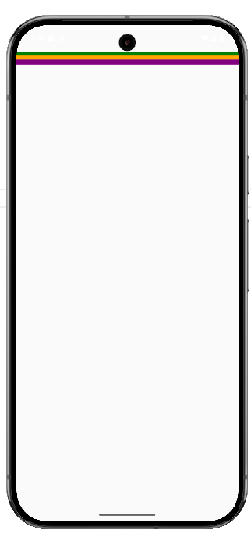
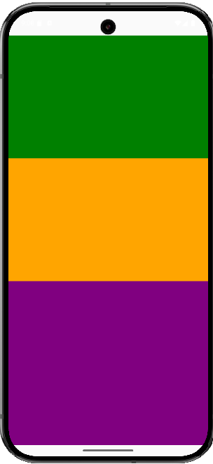
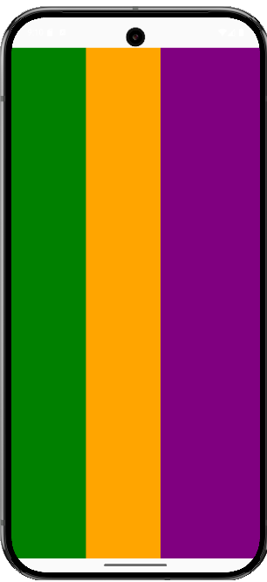
React Native Components - Fundamentals
<View> Element
Output:
OR
<SafeAreaView style={{height: 100, flexDirection: 'column'}}>
<SafeAreaView style={{flex: 1, flexDirection: 'column'}}>
<SafeAreaView style={{flex: 1, flexDirection: 'row'}}>

Slide 18
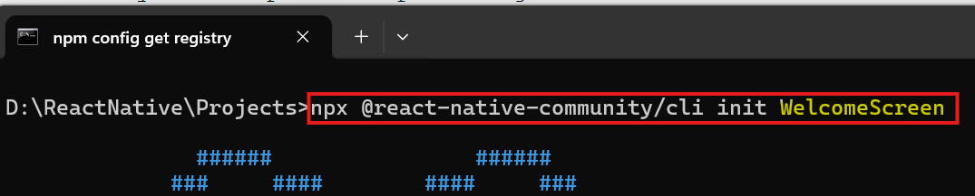
React Native Components - Fundamentals
<Text> Element
The Text component in React Native is used to display textual content on the screen
It works similarly to a <p> or <span> tag in HTML
Supports styling, nesting, and event handling (like onPress)
Consider that we're creating a Welcome Screen for a mobile banking app:

Slide 19
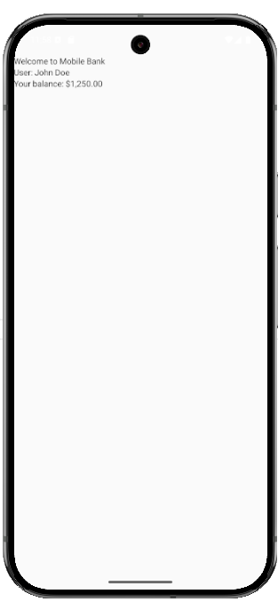
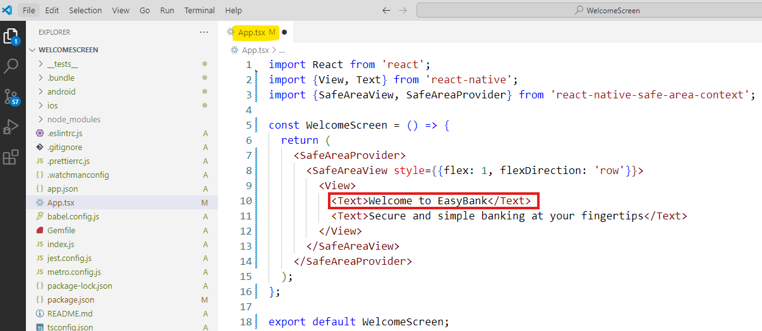
React Native Components - Fundamentals
<Text> Element
We have used three Text elements: one for a headline and two for subtexts
We have not applied any styling to these Text elements and so we cannot see any visual effect of header and sub header

Slide 20
React Native Components - Fundamentals
<Text> Element
<View> plays a similar role to <div> in web development
In this specific case, <View> is used to:
Group multiple <Text> elements:
React Native requires a single root component in a return block
You cannot return multiple <Text> elements side by side without wrapping them in a parent
Here <View> serves that purpose

Slide 21
React Native Components - Fundamentals
StyleSheets in React Native
In React Native, StyleSheet is used to define styles for components
It is similar to CSS on the web
Instead of using inline styles everywhere (which can get messy), we define all styles in one place using StyleSheet.create() and apply them with the ‘style’ prop
This approach offers:
Cleaner code
Better readability
Performance optimizations

Slide 22
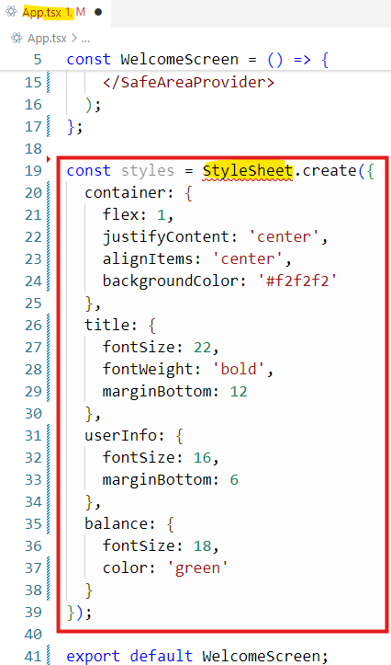
React Native Components - Fundamentals
StyleSheets in React Native
Let’s now refactor our “Welcome Screen" to use StyleSheet to style the <View> and <Text> elements
Create a new StyleSheet

Slide 23
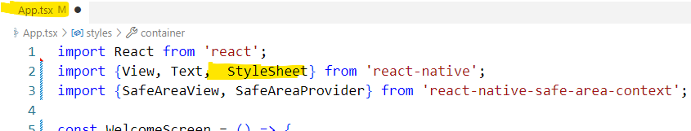
React Native Components - Fundamentals
StyleSheets in React Native
Import the StyleSheet module from react-native package
const styles = StyleSheet.create({...}): Creates a centralized style object named ‘styles’ using React Native's StyleSheet API
container, title, userInfo, and balance: These are named style objects created to organize and apply consistent styling to different parts of the UI, such as the layout (container), headings (title), user details (userInfo) etc.

Slide 24
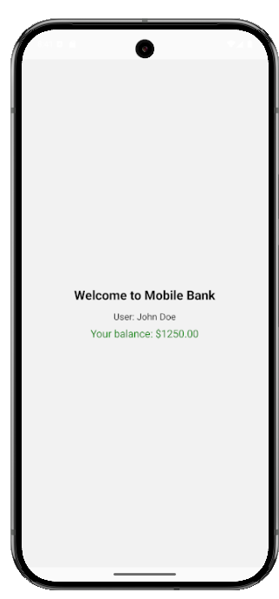
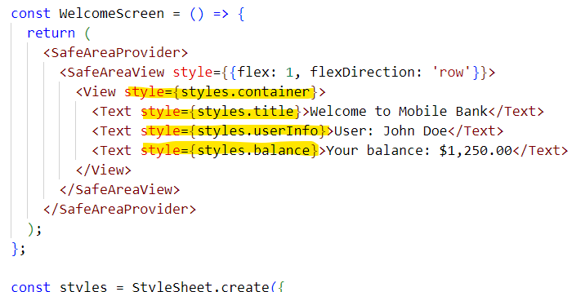
React Native Components - Fundamentals
StyleSheets in React Native
Apply the predefined styles to components
style={styles.container} is applying a set of predefined styles to the <View> component using the named style object called container
This line tells React Native, “Use the layout and design defined in the container style for this View
We can also reuse the same style across multiple components or screens

Slide 25
React Native Components - Fundamentals
State Variable
In React Native, a state variable is a special variable that allows a component to hold and manage dynamic data that can change over time
When the state changes, the component automatically re-renders to reflect the updated data
A state variable is declared using the ‘useState’ hook in a functional component
In React (and React Native), a hook is a special function that lets you “hook into” React features from inside a functional component, without using classes
A hook is a built-in function (like useState, useEffect, etc.) that allows functional components to:
Store state
Run side effects
Access context

Slide 26
React Native Components - Fundamentals
Common Hooks
Hook | Purpose
useState() | Adds local state to a component
useEffect() | Handles side effects like fetching data or timers
useContext() | Access context values without prop drilling
useRef() | Access or persist values without re-rendering
useMemo() | Optimize performance by memorizing expensive calculations
Hooks can only be used in functional components (not in classes)
They must be called at the top level of the component (not inside loops, conditions, or nested functions)
Hooks make functional components powerful and flexible, like class components

Slide 27
React Native Components - Fundamentals
State Variable – useState( ) Hook
A state variable is declared using the ‘useState’ hook in a functional component
Syntax:
const [variableName, setVariableName] = useState<type>(initialValue);
variableName – holds the current state value
setVariableName – is a function used to update that value
useState<type>() – declares the expected data type

Slide 28

React Native Components - Fundamentals
State Variable – useState( ) Hook
We’ll now use the useState hook to make the balance dynamic, which can later be updated based on real-time transactions
Let’s define a state variable called balance, initialized to 1250.00
useState creates a state variable called balance, initialized to 1250.00
setBalance() is used to update the balance dynamically

Slide 29
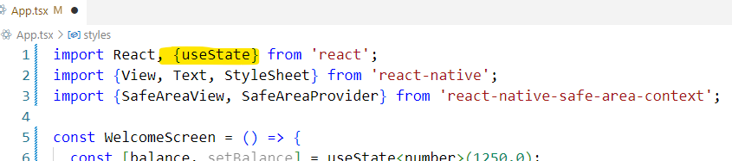
React Native Components - Fundamentals
Import the useState Hook from the React Library
useState is not available globally, it must be imported to use it in any file where you want to track changing data

Slide 30
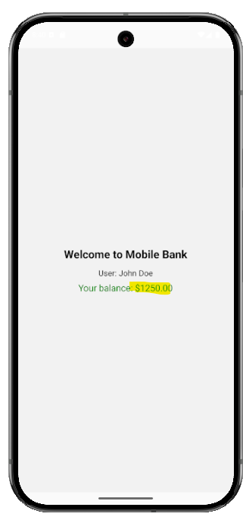
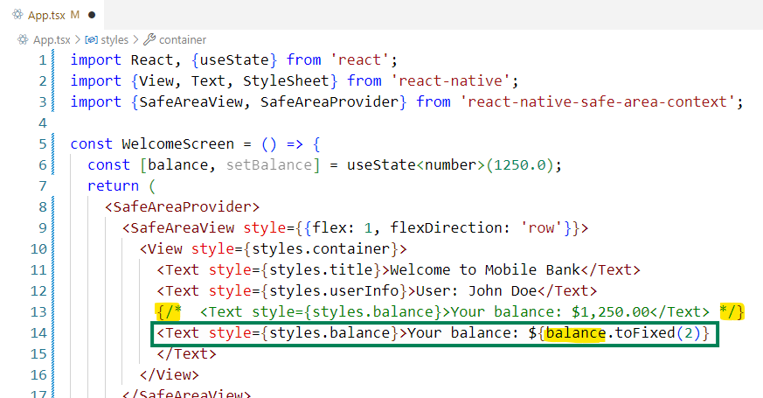
React Native Components - Fundamentals
Displaying State Value in Text
We can now use the state variable ‘balance’ to dynamically populate the balance in the Text element

Slide 31
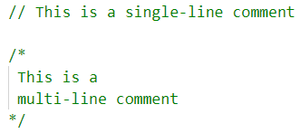


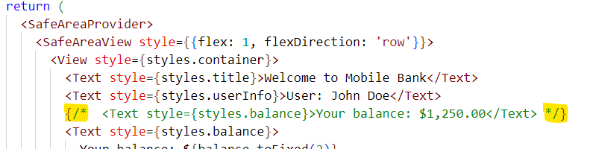
React Native Components - Fundamentals
Commenting in React Native
Outside regular TypeScript code (Outside return block):
Inside Tsx return block:
You cannot use // or /* */ directly
Instead, use JSX-safe comment syntax:

Slide 32
React Native Components - Fundamentals
Touchable Opacity
TouchableOpacity is a core component in React Native used to create touchable elements (like buttons or links) that respond visually when tapped
It reduces the opacity of the wrapped content when pressed, giving a subtle feedback effect to the user
Syntax:
TouchableOpacity: Wraps any element you want to make tappable
Can be used to wrap any component (like Text, View, or Image) to make it interactive
Commonly used for buttons, clickable text, or icons
Supports props like onPress, activeOpacity, etc.
onPress: Callback function triggered when the user taps the element
activeOpacity: Controls the opacity when the element is pressed (0 to 1)
<TouchableOpacity onPress=Function to execute on press>
<Text>Touchable content goes here</Text>
</TouchableOpacity>

Slide 33
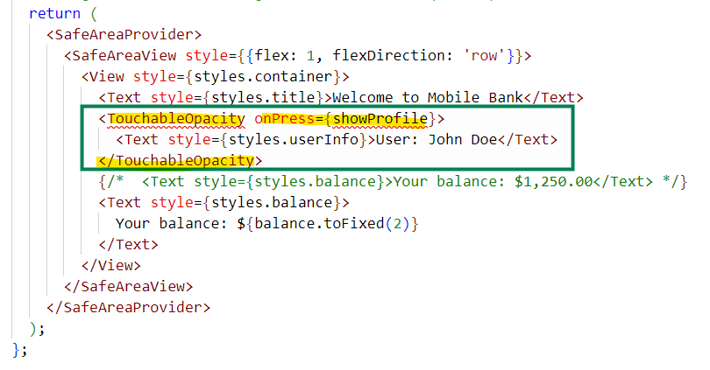
React Native Components - Fundamentals
Touchable Opacity - wrap the username Text view with a TouchableOpacity
You can wrap the username Text view with a TouchableOpacity component to make it respond to touch events like tapping or pressing
This adds interactivity, such as showing a profile or triggering an alert
‘showProfile’ is the function to be called when the text is tapped

Slide 34
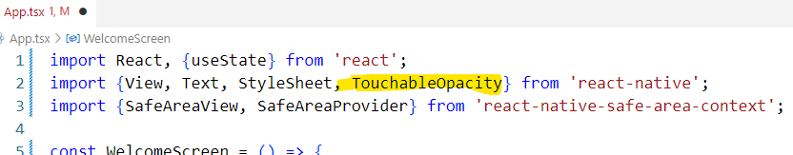
React Native Components - Fundamentals
Import TouchableOpacity Library
We need to import the TouchableOpacity library from the react-native package

Slide 35
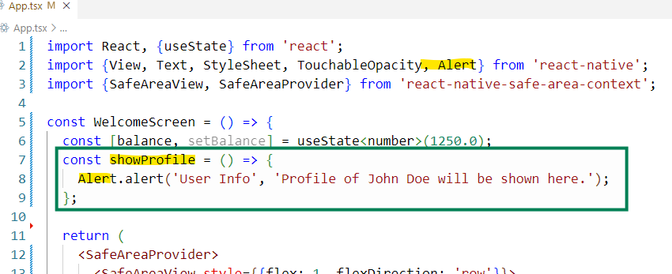
React Native Components - Fundamentals
Implement the Callback Function
Implement the ‘showProfile’ function:
In React Native, Alert is a built-in module used to show native alert dialogs to the user
You also need to import the ‘Alert’ library from react-native package

Slide 36
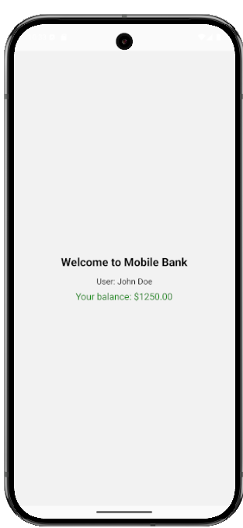
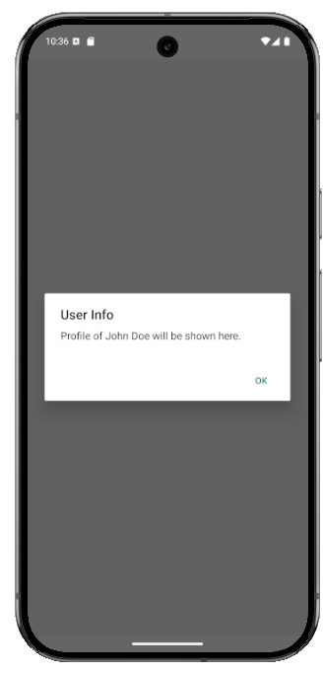
React Native Components - Fundamentals
TouchableOpacity Implemented on User Name
Tap the user name

Slide 37
React Native Components - Fundamentals
useEffect Hook
useEffect is a React Hook that runs a function after the component renders.
You can use it for:
Fetching data
Setting up subscriptions
Updating the UI based on certain changes
Cleanup tasks (e.g., removing timers, listeners)
Syntax:
import { useEffect } from 'react’;
useEffect(() => {
// Code to run after the component mounts or updates
}, [dependencies]);

Slide 38
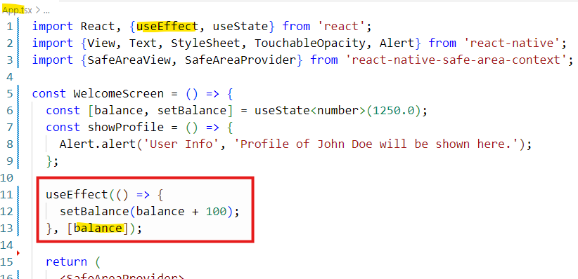
React Native Components - Fundamentals
useEffect Hook
The first argument is a callback function (what you want to do)
The second argument is a dependency array:
Dependencies [ ]: Runs once when the component mounts (like componentDidMount)
Array values - [value1, value2]: Runs whenever any of the listed values change
No array: Runs on every render of the component
Let’s say you want to simulate fetching the user’s balance from a server when the screen loads

Slide 39
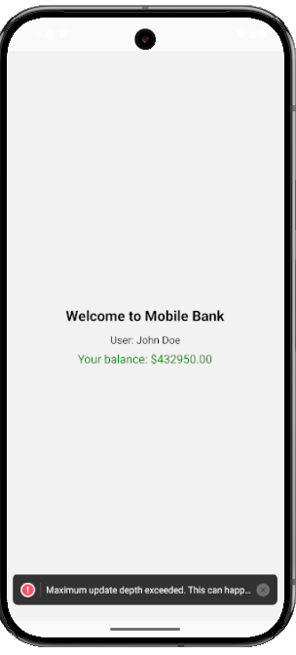
React Native Components - Fundamentals
useEffect Hook
This means:
“Every time balance changes, run this effect”
In this case, it creates an infinite loop of updates, because:
Initial balance = 1250
useEffect runs, sets balance = 1350
That change triggers useEffect again (because balance changed)
balance becomes 1450
Loop continues indefinitely

Slide 40
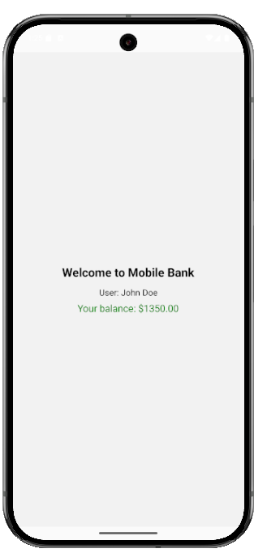
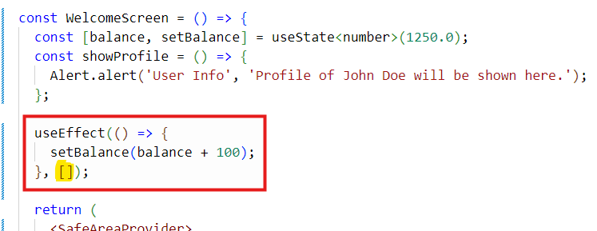
React Native Components - Fundamentals
useEffect Hook
If you want to increase the balance only once (like simulating an API call on load), use an empty dependency array:

Slide 41
React Native Components - Fundamentals
Working with Images
React Native provides a unified way of managing images and other media assets in your Android and iOS apps
In React Native, the Image component is used to display pictures from either local files or remote URLs
Syntax:
<Image source={...} style={...} />
source={...}: Specifies the image to display
style={...}: Defines how the image should look — size, shape, alignment, etc
1. Static Images (Local Images)
To add a static image to your app, place it somewhere in your source code tree and reference it in the Image element using the require( ) inside the source property
<Image source={require('./assets/profile.jpg')} />

Slide 42
React Native Components - Fundamentals
Working with Images
2. Network Images
Many of the images you will display in your app will not be available at compile time, or you will want to load some dynamically to keep the binary size down
Unlike with static resources, you will need to manually specify the dimensions of your image
It's highly recommended that you use https as well in order to satisfy App Transport Security requirements on iOS
Synatx:
<Image source={{ uri: 'https://your-image-url' }} style={{ ... }} />
uri: The URL of the image to be loaded from the web
style={...}: Defines how the image should look — size, shape, alignment, etc

Slide 43
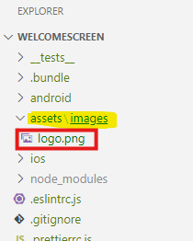
React Native Components - Fundamentals
Working with Images – Load a Local Image
Let’s display a bank logo at the top
Create the folders assets\images under the root of the project
Store an image logo.png in the images folder

Slide 44
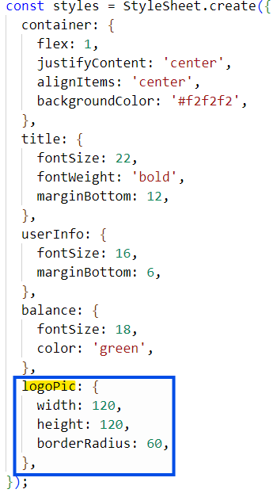
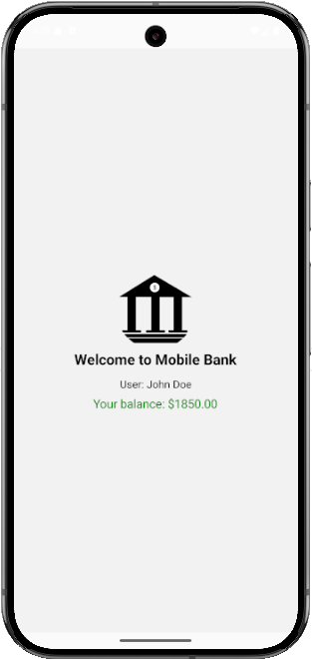
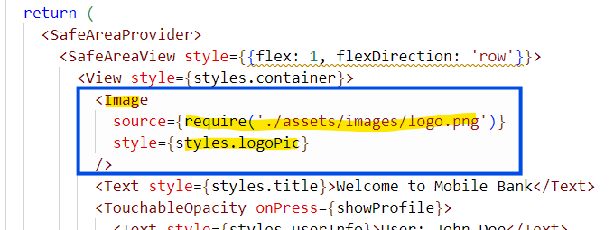
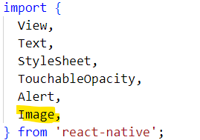
React Native Components - Fundamentals
Working with Images – Load a Local Image
Create an Image element and load logo.png in it
Define the style ‘logoPic’
Import the Image component

Slide 45
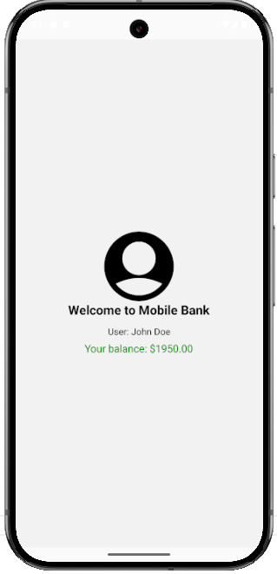
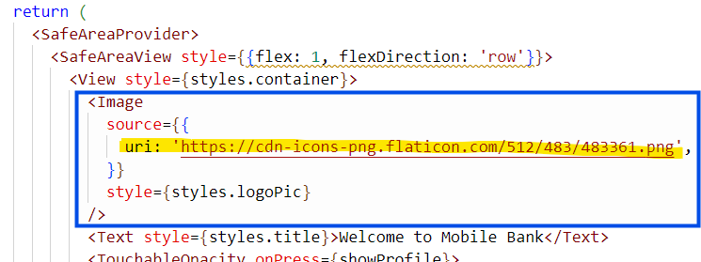
React Native Components - Fundamentals
Working with Images – Load a Network Image
Replace the local logo image with a network image
https://cdn-icons-png.flaticon.com/512/483/483361.png

